Slide 1
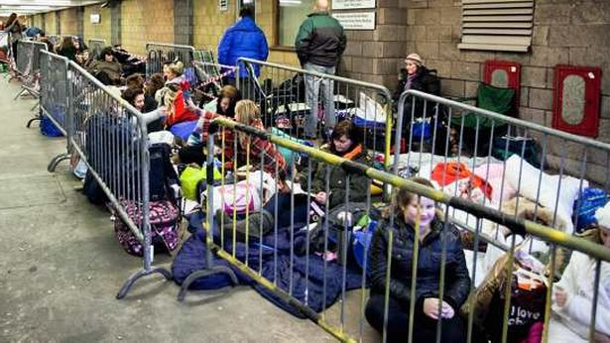

Slide 2
Genesis 12
Old
Now
To come
Testament
People
Israel
Visible church
Invisible
church
Place
Promised
Scattered but
New heavens
Land
united to
& earth
Christ
Presence
Temple
Holy Spirit
Dwelling
indwelling
with man
believers

Slide 3
Redemptive History
the unfolding events in Scripture that God uses to redeem His people from sin, fulfilled in Jesus, so that His people know and worship Him.

Slide 4
Fact File: Matthew
Written: 70-80 AD
Key Themes:
Life-long learners of Jesus 28:19-20
Jesus fulfils the Messianic hope to Israel and all nations
Jesus is King
God’s Kingdom

Slide 5
Fact File: Mark
Written: 50-60 AD
Key Themes:
Mark 10:45 – For the Son of Man came not to be served but to serve, and to give his life as a ransom for many
Jesus is the Kingly Messiah
Jesus is God’s suffering servant

Slide 6
Fact File: Luke
Written: 64-70 AD
Key Themes:
Luke 2:10 – “Good news of Great Joy for all people”
Jesus seeks the lost
Jesus is King

Slide 7
Fact File: John
Written: 90-95 AD
Key Themes:
John 20:31 – “but these are written so that you may believe that Jesus is the Christ, the Son of God, and that by believing you may have life in his name”

Slide 8
Fact File: John
Chapters 1-11 – the book of signs
Chapters 12 – 21 – passion, death and resurrection
11:53 – acts as the link or transition
I am sayings – indicate that Jesus is the source of life
7 signs – so that people would believe

Slide 9
The Cry
My God, my God, why have you forsaken me?
John 19:30 – It is finished

Slide 10
The Curtain
Curtain of the temple torn in two, from top to bottom

Slide 11
The Centurion
Truly this man was the Son of God

