Slide 1
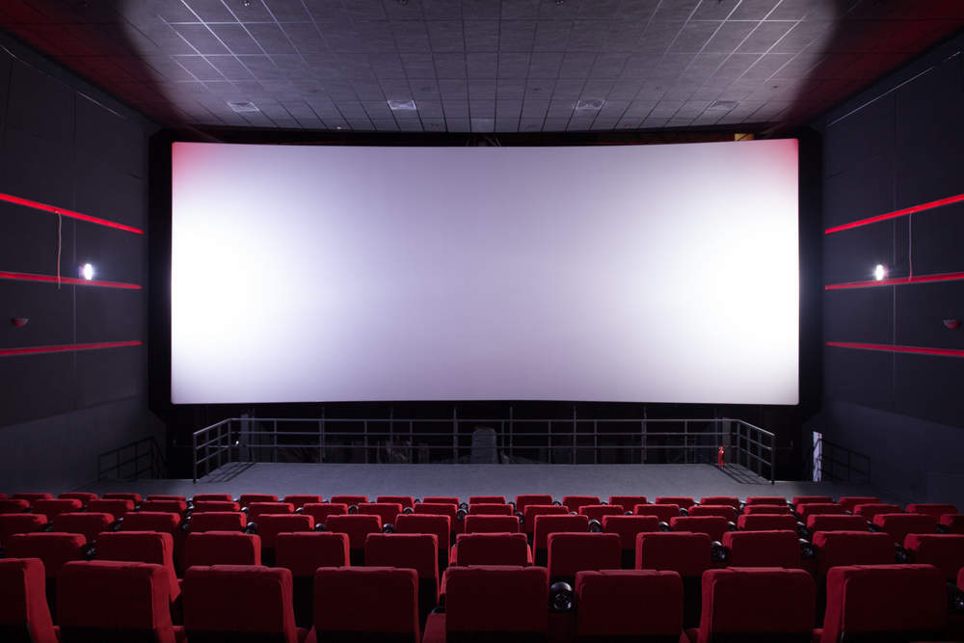
ACTS IS A SEQUEL

Slide 2
Different Acts but 1 story
Creation
Fall
Promise
Gospel
Mission
New Creation

Slide 3
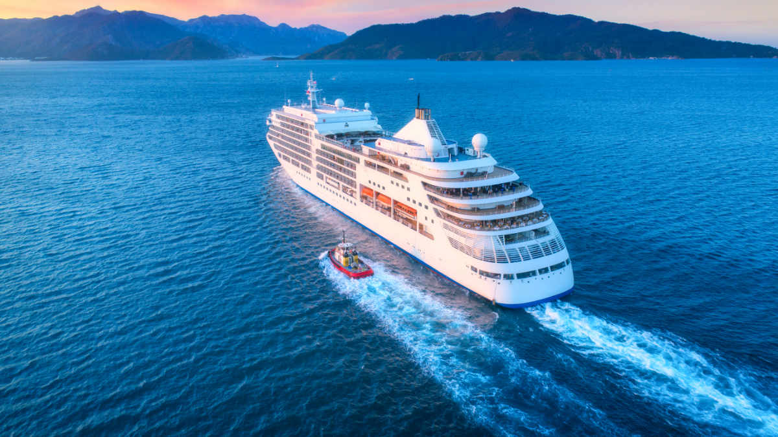

Slide 4
Acts is Part II for Theophilus – Acts 1:1
Luke ends & Acts begins with Jesus’ ascension
Luke 2:10 – Good news of great joy for all people
Acts – is Luke 2:10 being expanded
Luke begins at the centre of the Jewish world
Acts ends at the centre of the Gentile world

Slide 5
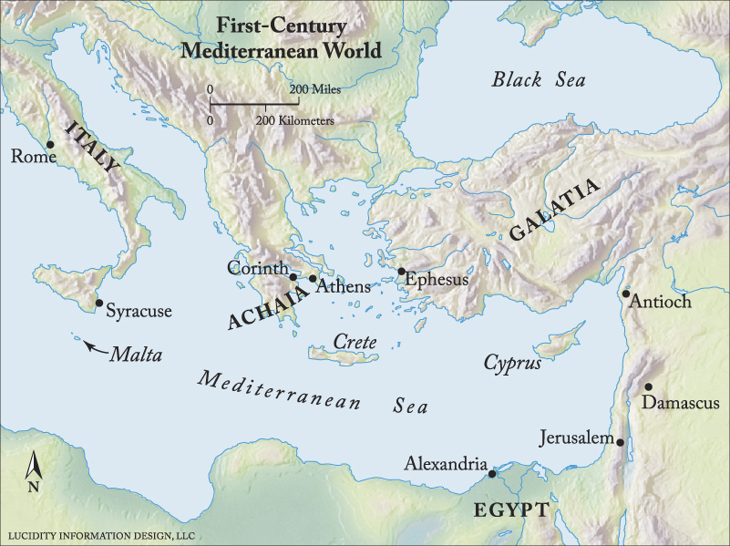
Acts 1:8
“you will be my witnesses in
Jerusalem and in all Judea
and Samaria,
and to the end of the earth”

Slide 6
Jerusalem & Judea (Chapters 1-7)
Jesus’ ascension
Pentecost
One-off event
Reversal of Babel
Stephen’s death
Martyr – witness for Jesus

Slide 7
Samaria (Chapters 8-12)
Persecuted and scattered
Philip in Samaria (and others)
8:4-5 (preaching the word)
Saul’s conversion
Acts 9:15-16
Peter’s vision

Slide 8
Ends of the earth (Chapters 13-28)
Journey 1 – 13:1 – 14:28
Journey 2 – 15:36 – 18:21
Journey 3 – 18:23 – 21:14
Journey to Rome (21:27-28)
4th missionary journey?
(Acts 28:28-30)

Slide 9
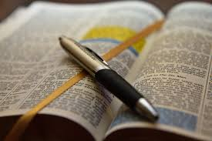
Preaching
Speaking the Word of God
Power of the Spirit enables us

Slide 10
Prayer
Devoted themselves to praying
We need to devote ourselves to prayer
We also need to act…

Slide 11
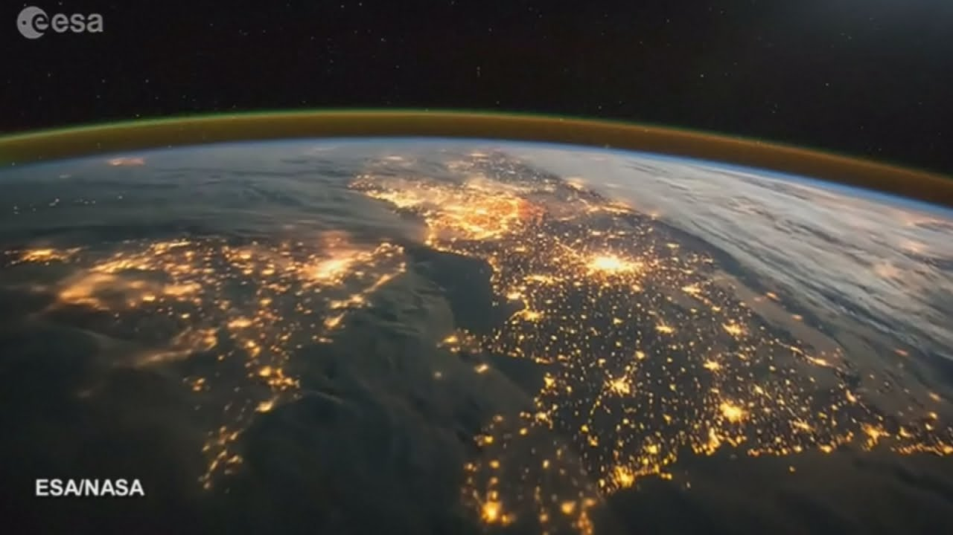
People
Went to seek and save the lost
Who needs to hear?
Acts 1:8 - you will be my witnesses in Jerusalem and in all Judea and Samaria, and to the end of the earth

Slide 12
People
In your street / road / townland
Magherafelt / Desertmartin
Mid-Ulster
The ends of the earth

Slide 13
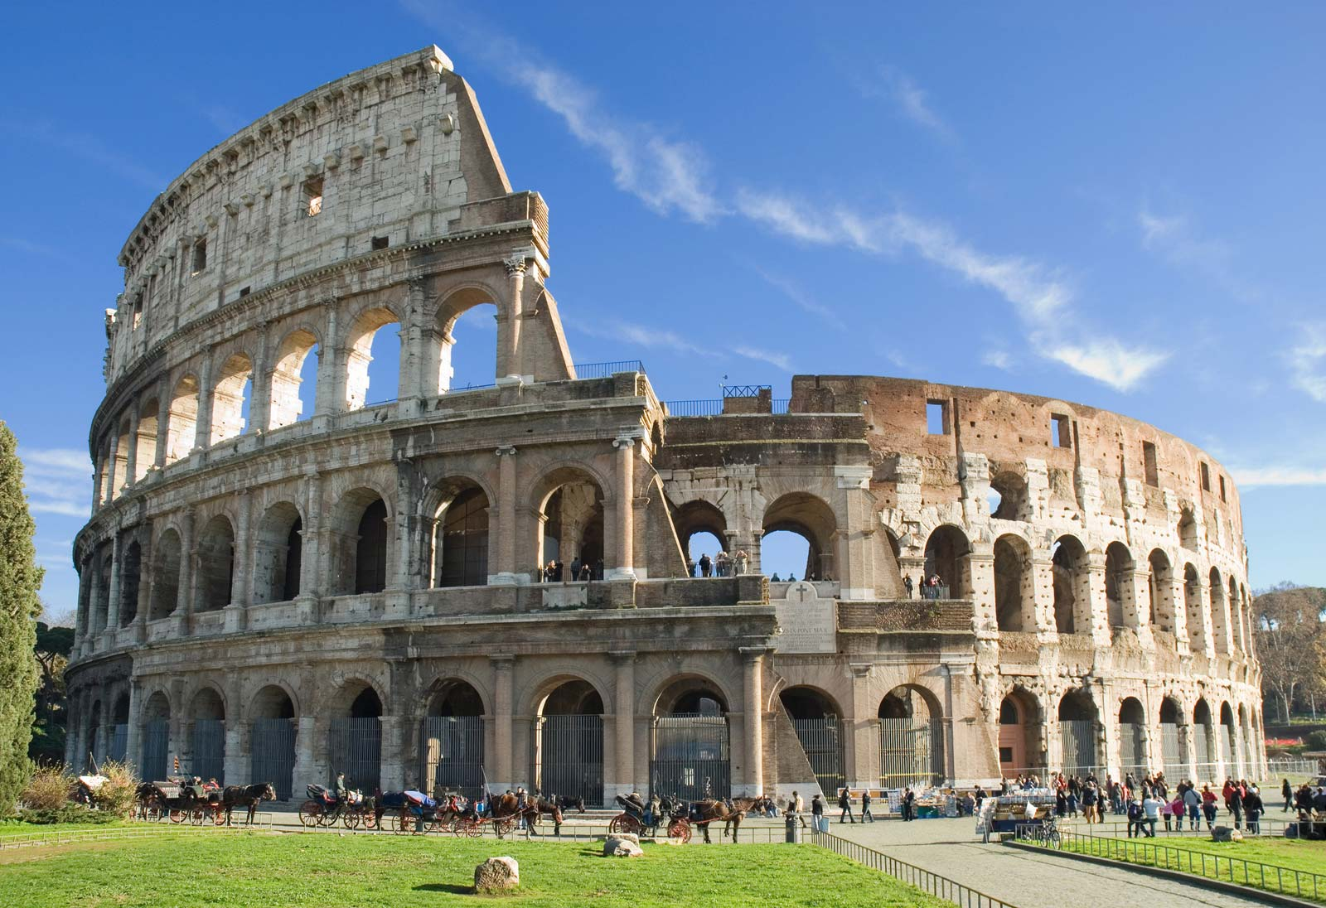
Persecution
Constant opposition to the gospel
Stephen stoned
Christians scattered
James killed
Paul imprisoned

